Slide 1
GCBASIC
PIC18FxxQ24
Part 10 - EEPROM Operations

Slide 2
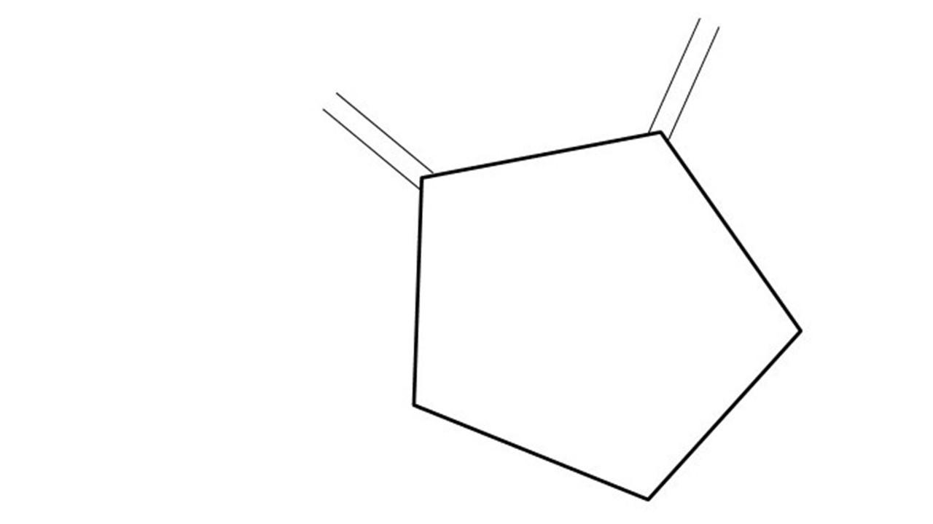
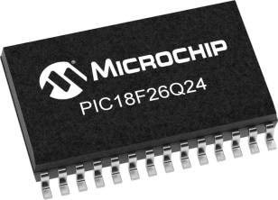
GCBASIC
PIC18FxxQ24
Part 10 - EEPROM Operations

Slide 3
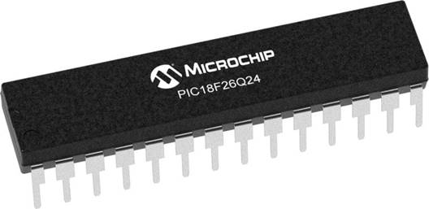
GCBASIC
Like and subscribe!

Slide 4
PIC18FxxQ24
PIC18-Q24 is a high performance PIC18
Digital and Analog peripherals
10-bit ADC
Multiple communication interfaces
Serial, I2C and SPI
PWM – CCP/PWM and 16Bit
Configurable Logic Cells
Multi voltage domains
The PIC18xxQ24 offers 28, 40 and 48-pin products in small footprint packages to support customers in a wide variety of applications.

Slide 5
Videos...
Install the hardware and make the board work – three LED programs
Make four LEDs flash in a sequence
Set the LEDs to represent the value of ADC
Sequence the LEDs with a delay using the value of ADC
Using an input to set the state of the LEDs
Using the reset switch
Using the switch, ADC – make the LEDs flash in a sequence with reverse
Using the serial to display values
Using the timer0 overflow, 8bit timer, 16bit timer to flash the LEDs
Using EEProm – showing values on the serial terminal, and more constants insights
Using I2C with serial to discover I2C devices
Using an I2C GCLD display
Using a SPI GCLD display
Using PWM, 7 ways, to dim the LEDS
Using an external interrupt to control an LED
Using storage within the chip – Progmem, SAF memory, EEPROM and DATA blocks
Using CLC
The GCBASIC tool chain
Assembly , alternatives assemblers and MPLAB-X
Summary

Slide 6
GCBASIC Compiler
GCBASIC Compiler
GCBASIC is an Open Source compiler for PIC and AVR microcontrollers
GCBASIC now supports the 18FxxQ24 chip family

Slide 7
Prerequisites
Assumes you have
Installed the GCBASIC software
Installed your programmer software
Test that you have the 18FxxQ24 attached
You have the 4 LEDs operating
You have a POT connected
You have SWITCHes connected
You have a USB/TTL converter

Slide 8
Hardware
Hardware
-------------------PORTA----------------
Bit#: -7---6---5---4---3---2---1---0---
IO: ----------------SW----------ADC--
----------------------------------------
-------------------PORTB----------------
Bit#: -7---6---5---4---3---2---1---0---
IO: ----------------LED-LED-LED-LED--
----------------------------------------
------------------PORTC-----------------
Bit#: -X---6---5---4---3---2---1---0---
IO: -^--TX---------------------------
-----VDDIO2-----------------------------
You must apply correct Voltage
------------------PORTE-----------------
Bit#: -----------------3---------------
IO: ----------------SW---------------
Prototype Board
Power 5v0
Programmer
LEDs & resistors
Switches & resistors

Slide 9
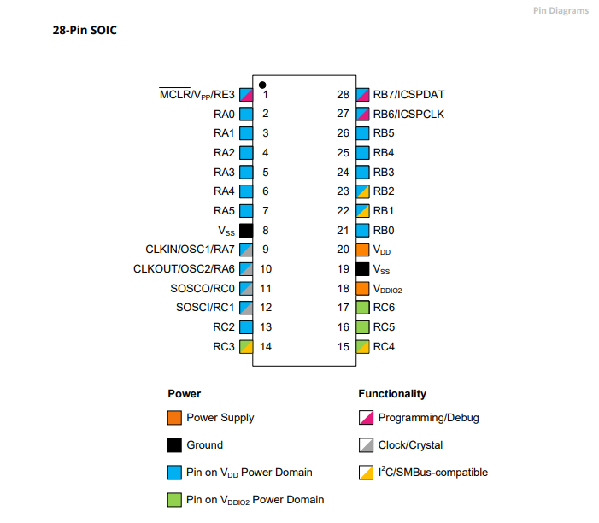
Power Domain – VDDIO2

Slide 10
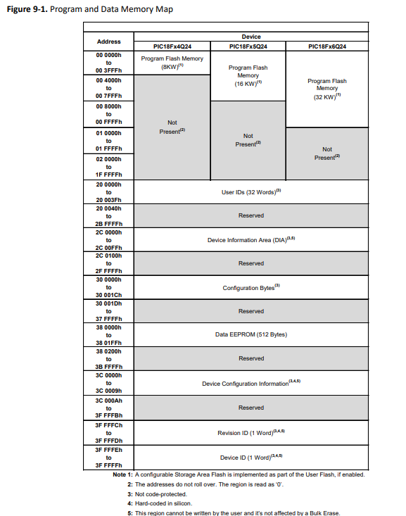
Memory
64 KB of Program Flash Memory
4 KB of Data SRAM Memory
512 Bytes Data EEPROM
Memory Access Partition, the Program Flash Memory Can Be Partitioned into:
Application Block
Boot Block
Storage Area Flash (SAF) Block

Slide 11
EEProm
Electrically Erasable Programmable Read-Only Memory
Non-volatile memory to store relatively small amounts of data but allowing individual bytes to be erased and reprogrammed.

Slide 12
EEProm
Type Value Explanation
Prog 32768 Prog is exposed as ChipWORDS
SAFMemWords 128 SAFMemWords exposed ChipSAFMemWords
EEPROM 512 EEPROM is exposed as ChipEEPROM
RAM 4096 RAM is exposed as ChipRAM

Slide 13
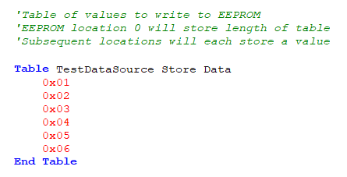
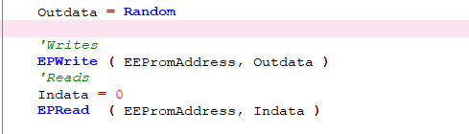
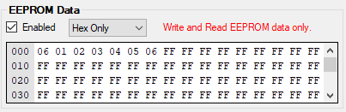
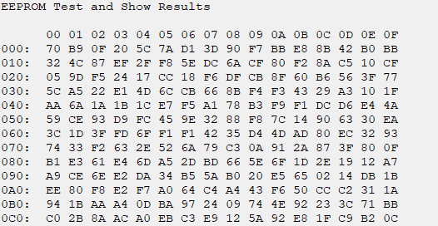
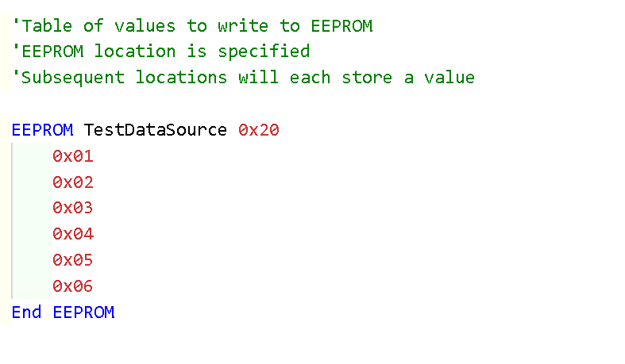
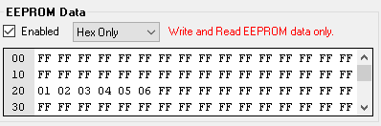
EEProm – 3 ways

Slide 14
Lab
Sample code – write and read via terminal
Using PPS select the serial USART port
Write values to EEProm
Read values to EEProm
See the results on terminal
Sample code – write with read via programmer
Write values to EEProm
See the results within PICKitPlus
Sample code – check the chip specific constant
See the results on terminal

Slide 16
Videos...
Install the hardware and make the board work – three LED programs
Make four LEDs flash in a sequence
Set the LEDs to represent the value of ADC
Sequence the LEDs with a delay using the value of ADC
Using an input to set the state of the LEDs
Using the reset switch
Using the switch, ADC – make the LEDs flash in a sequence with reverse
Using the serial to display values
Using the timer0 overflow, 8bit timer, 16bit timer to flash the LEDs
Using EEProm – showing values on the serial terminal, and more constants insights
Using I2C with serial to discover I2C devices
Using an I2C GCLD display
Using a SPI GCLD display
Using PWM, 7 ways, to dim the LEDS
Using an external interrupt to control an LED
Using storage within the chip – Progmem, SAF memory, EEPROM and DATA blocks
Using CLC
The GCBASIC tool chain
Assembly , alternatives assemblers and MPLAB-X
Summary

Slide 17
GCBASIC
PIC18FxxQ24
Part 10 - EEPROM Operations

